Slide 1
Medical Imaging Computing
Conferences and Journals
International Symposium on Biomedical Imaging (ISBI)
SPIE Medical Imaging
Medical Image Computing & Computer Assisted Intervention (MICCAI)
Medical Imaging Analysis (MedIA)
IEEE Transactions on Medical Imaging (IEEE TMI)
Scientific Reports
Journal of Medical Imaging (JMI)
Nature Biomedical Engineering
FAPS – INF6900 (Medical Image Computing)

Slide 2
Table of contents
01
02
Conferences
Journals
ISBI
SPIE Medical Imaging
MICCAI
Overview of 3 conferences
MedIA
JMI
IEEE TMI
Nature Biomedical Engineering
Scientific Reports
Overview of 5 journals
FAPS – INF6900 (Medical Image Computing)

Slide 3
01
Conferences
FAPS – INF6900 (Medical Image Computing)

Slide 4
International Symposium on Biomedical Imaging (ISBI)
01. Conferences
ISBI
“The IEEE International Symposium on Biomedical Imaging (ISBI) is a scientific conference dedicated to mathematical, algorithmic, and computational aspects of biological and biomedical imaging, across all scales of observation. It fosters knowledge transfer among different imaging communities and contributes to an integrative approach to biomedical imaging.”
FAPS – INF6900 (Medical Image Computing)

Slide 5
ISBI overview
01. Conferences
ISBI
Website | https://biomedicalimaging.org/2025/
Reviews | Single blind
Highlights of this conference | Smaller conference (than SPIE Medical Imaging and MICCAI) Engineering oriented (IEEE) Networking events
Acceptance rate | For the 2022 edition : Oral Presentation : ~13 % Posters : ~30 % (Numbers taken from the proceedings of the 2022 edition)
« Specialty » | Image processing, Image analysis, Modelling, Imaging informatics, AI applied to medical images (detection, diagnosis, prognosis, etc.)
Criteria for paper selection | High-quality papers containing original contributions in the topics of interest (see “Specialty” above)
Length restrictions in published papers | 4 page maximum, 1 page extra for non-technical content
FAPS – INF6900 (Medical Image Computing)

Slide 6
Activities at ISBI
01. Conferences
ISBI
Special Sessions
4-5 invited speakers (experts in their fields), each exploring different facets of a chosen topic
Tutorials
~ 8 Tutorials at the 2024 edition
Workshops
~ 4 Workshops at the 2024 edition
Challenges
Prior to the conference, tasks, datasets and metrics are given. Teams achieving highest performance present their methods at the conference
~ 6 Challenges at the 2024 edition
Demos
Selected participants will show solutions, software, new concepts etc.
Pitch Competitions
Symposium participants can share their startup ideas with the ISBI community
Keynotes
Poster sessions
Conference talks
FAPS – INF6900 (Medical Image Computing)

Slide 7
ISBI submission and review process
01. Conferences
ISBI
What can we submit ?
1-page abstract
Peer reviewed (single blind), can lead to poster presentation
OR
4-page scientific article
Peer reviewed (single blind), can lead to either oral or poster presentation, and will be published in IEEE Xplore (conference proceedings)
FAPS – INF6900 (Medical Image Computing)

Slide 8
ISBI submission and review process (4-page paper)
01. Conferences
ISBI
4-page article are submitted
Reviewers and associate editors (meta-reviewers) are recruited and assigned to different submissions. Anyone can send an application to become a reviewer. The reviews are made in a single-blind manner.
Reviewers and ultimately the meta reviewer grade the submission. A decision « accept » or « reject » is made and communicated to the submitters.
If the paper is accepted, the submitters have a few weeks to prepare the camera-ready article (not reviewed again). There is no rebuttal.
FAPS – INF6900 (Medical Image Computing)

Slide 9
ISBI submission and review process (4-page paper)
01. Conferences
ISBI
Manuscript submission
4-page maximum
Reviews
Accept / Reject decision
No rebuttal
Camera-ready submission
4-page maximum
1 optional additionnal page (non-technical content only)
1 month
3 months
FAPS – INF6900 (Medical Image Computing)

Slide 10
What will be published and where ?
01. Conferences
ISBI
4 page article, with an extra page for non-technical content only (acknowledgments, references, etc.) will be published in IEEE Xplore
ISBI dates
Dates for the 2025 edition :
4-page paper submission deadline : September 27th 2024
Accept / Reject notification : December 20th 2024
Final submission : January 17th 2025
Conference : April 14th to 17th 2025
Publication in IEEE Xplore : some months after the conference
FAPS – INF6900 (Medical Image Computing)

Slide 11
Important (most cited) ISBI articles (2020-2024) (according to Publish or Perish, Google Scholar search)
01. Conferences
ISBI
MedMNIST Classification Decathlon: A Lightweight AutoML Benchmark for Medical Image Analysis
314 citations on Google Scholar in July 2024
From the 2021 18th ISBI edition
Slake: A Semantically-Labeled Knowledge-Enhanced Dataset for Medical Visual Question Answering
142 citations on Google Scholar in July 2024
From the 2021 18th ISBI edition
MMBERT: Multimodal BERT Pretraining for Improved Medical VQA
133 citations on Google Scholar in July 2024
From the 2021 18th ISBI edition
Self Pre-Training with Masked Autoencoders for Medical Image Classification and Segmetnation
110 citations on Google Scholar in July 2024
From the 2023 20th ISBI edition
FAPS – INF6900 (Medical Image Computing)

Slide 12
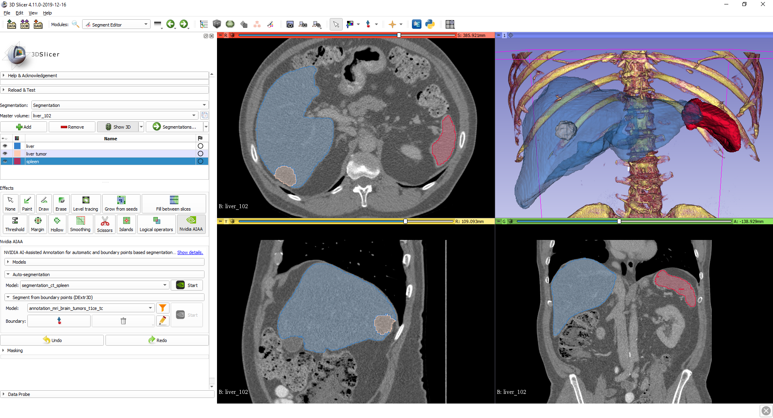
Best paper award (2024 edition)
01. Conferences
ISBI
DCSM 2.0: Deep Conditional Shape Models for Data Efficient Segmentation
Not published yet but available on arxiv :
https://arxiv.org/abs/2407.00186
Important ISBI articles – old but worth noting
3D Slicer
855 citations on Google Scholar in July 2024
From the 2004 2nd ISBI edition
Software still used to this day
FAPS – INF6900 (Medical Image Computing)

Slide 13
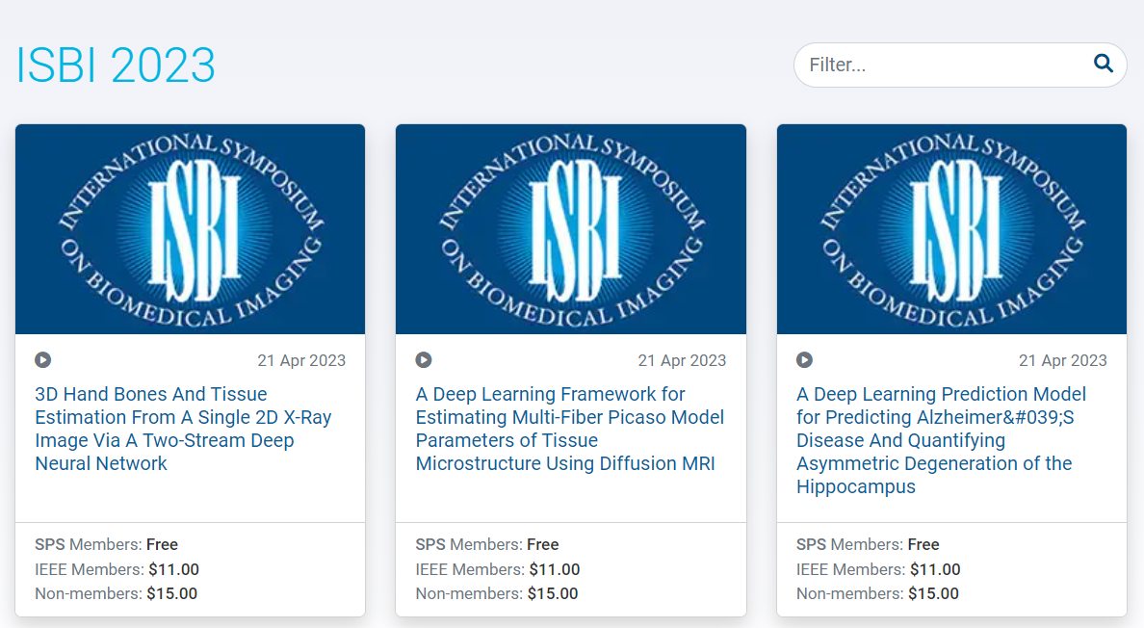
ISBI presentations
01. Conferences
ISBI
Not available free of charge. But for members :
FAPS – INF6900 (Medical Image Computing)

Slide 14
ISBI presentations
01. Conferences
ISBI
Some available on YouTube (most of them without cameras):
DBAHNET : Dual-Branch Attention-Based Hybrid Network for High-Resolution 3D Micro-CT Bone Scan Segmentation (2024 21st ISBI edition)
https://www.youtube.com/watch?v=wTD828Nixvc
Insights from Learned Filters of Vision CNNs (2023 20th ISBI edition)
https://www.youtube.com/watch?v=UT_UwmUx384
SAVGAN: Self-Attention Based Generation of Tumour on Chip Videos (2022 19th ISBI edition)
https://www.youtube.com/watch?v=4D8N-qr9WSA
MAg: a simple learning-based patient-level aggregation method for detecting microsatellite instability from whole-slide images
https://www.youtube.com/watch?v=Ln60y3aGthc
FAPS – INF6900 (Medical Image Computing)

Slide 15
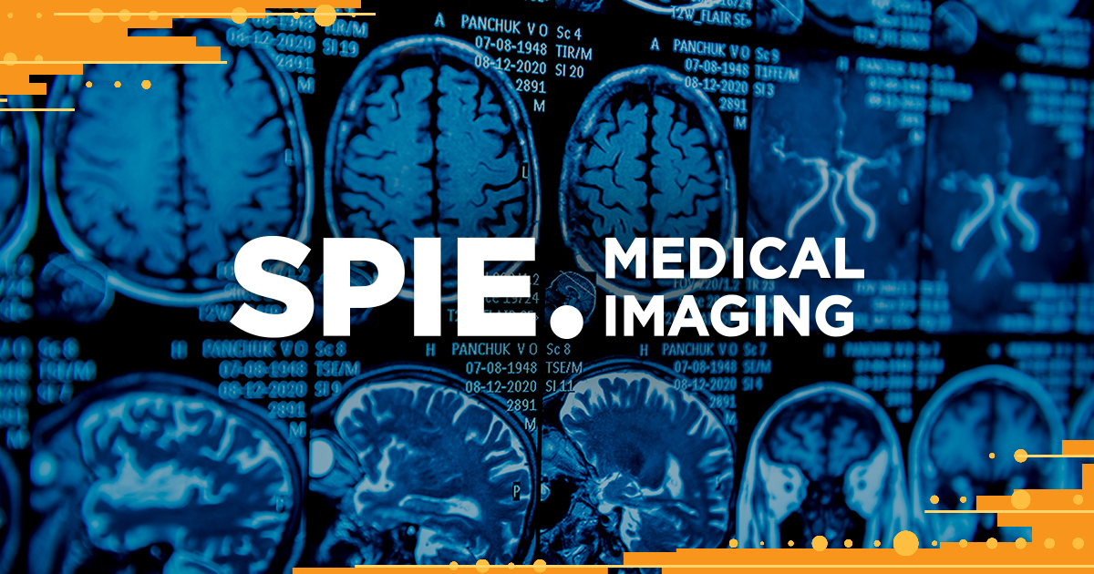
SPIE Medical Imaging
01. Conferences
SPIE Medical Imaging
“Come share with—and learn from—world experts, researchers, and innovators discussing advancements in image processing, physics, computer-aided diagnosis, perception, image-guided procedures, biomedical applications, ultrasound, informatics, radiology, and digital pathology. The conference topics include an increased focus on fast emerging areas such as deep learning, AI, machine learning, and information fusion. ”
FAPS – INF6900 (Medical Image Computing)

Slide 16
SPIE Medical imaging overview
01. Conferences
SPIE Medical Imaging
Website | https://spie.org/conferences-and-exhibitions/medical-imaging#_=_
Reviews | Only abstracts are reviewed, no review for the manuscript
Highlights of this conference | Exhibition hall filled with companies and their products Courses with SPIE certification Very big conference with lots of attendees
Acceptance rate | No official public numbers found 79 % in a specific sub-conference in 2021 (https://www.spiedigitallibrary.org/journals/journal-of-medical-imaging/volume-9/issue-S1/012208/SPIE-Computer-Aided-Diagnosis-conference-anniversary-review/10.1117/1.JMI.9.S1.012208.full)
« Specialty » | Image processing, physics, imaging modalities (ultrasound, radiology)
Criteria for paper selection | Could be different for all sub-conferences “Only original material should be submitted. Commercial papers, papers with no new research/development content, and papers with proprietary restrictions will not be accepted for presentation.”
Length restrictions in published papers | Minimum 4 pages
FAPS – INF6900 (Medical Image Computing)

Slide 17
SPIE Medical Imaging
01. Conferences
SPIE Medical Imaging
SPIE hosts HUGE conferences. They are organized by grouping lots of differences conferences together, and hosting them all together in a big conference center. For the 2025 SPIE Medical Imaging conference, 9 conferences are happening at the same time :
Physics of Medical Imaging
Image Processing
Computer-Aided Diagnosis
Image-Guided Procedures, Robotic Interventions, and Modeling
Image Perception, Observer Performance, and Technology Assessment
Clinical and Biomedical Imaging
Imaging Informatics
Ultrasonic Imaging and Tomography
Digital and Computational Pathology
FAPS – INF6900 (Medical Image Computing)

Slide 18
Activities at SPIE Medical Imaging
01. Conferences
SPIE Medical Imaging
Courses
Created by experts in industry and academia
SPIE certificate given at the end of the course
Technical sessions
Panel discussions with experts
Networking sessions
Workshops
Live demonstrations
~ 5 technical sessions for the 2024 edition
Exhibitions
Companies present their products at booths in a conference hall
Keynotes
Posters
Conference talks
FAPS – INF6900 (Medical Image Computing)

Slide 19
SPIE Medical Imaging submission and review process
01. Conferences
SPIE Medical Imaging
What do we need to submit ?
Extended abstract : 200-300 words (abstract) and a 2-to-4 page file containing the methods, results, conclusions
FAPS – INF6900 (Medical Image Computing)

Slide 20
SPIE Medical Imaging submission and review process
01. Conferences
SPIE Medical Imaging
The submitters chose the specific conference that they want to submit to
Extended abstract is submitted
(The recruitement of reviewers is not really explained. It seems the abstracts are evaluated by the Area Chairs of the specific conference. The level of blindness is not clear either.)
Reviewers grade the submission. A decision « accept » or « reject » is made and communicated to the submitters.
If the paper is accepted, the submitters have a few months to prepare their manuscript (not reviewed again). There is no rebuttal.
FAPS – INF6900 (Medical Image Computing)

Slide 21
SPIE Medical Imaging submission and review process
01. Conferences
SPIE Medical Imaging
Submit extended abstract
200-300 words abstract + 2-4 page article
Reviews
Accept / Reject decision
No rebuttal
Manuscript submission
Minimum of 4 page
No maximum length
3 months
3 months
FAPS – INF6900 (Medical Image Computing)

Slide 22
What will be published and where ?
01. Conferences
SPIE Medical Imaging
Manuscript (no maximum length, minimum of 4 pages) will be published in SPIE Digital Library
If the submitter is chosen for an oral presentation :
The presentation (slides and video / voice over) is recorded during the meeting and published in SPIE Digital Library
If the submitter is chosen for a poster :
The poster (in PDF format) is published in SPIE Digital Library
SPIE Medical Imaging dates
Dates for the 2025 edition :
Abstract due : August 7th 2024
Author notification : October 28th 2024
Manuscript due : January 29th 2025
(the dates might change depending on the specific sub-conference, these are for the Clinical and Biomedical Imaging conference)
FAPS – INF6900 (Medical Image Computing)

Slide 23
Important (most cited) SPIE Medical Imaging articles (2020-2024) (according to Publish or Perish, Google Scholar search)
01. Conferences
SPIE Medical Imaging
CaraNet: context axial reverse attention network for segmentation of small medical objects
158 citations on Google Scholar in July 2024
From Medical Imaging 2022 Conference
DC-UNet: rethinking the U-Net architecture with dual channel efficient CNN for medical image segmentation
149 citations on Google Scholar in July 2024
From Medical Imaging 2021 Conference
ESFPNet: efficient deep learning architecture for real-time lesion segmentation in autofluorescence bronchoscopic video
47 citations on Google Scholar in July 2024
From Medical Imaging 2023 Conference
FAPS – INF6900 (Medical Image Computing)

Slide 24
Best paper award (2024 edition)
01. Conferences
SPIE Medical Imaging
Some examples
Characterizing browser-based medical imaging AI with serverless edge computing: towards addressing clinical data security constraints
https://www.spiedigitallibrary.org/conference-proceedings-of-spie/12469/1246907/Characterizing-browser-based-medical-imaging-AI-with-serverless-edge-computing/10.1117/12.2653626.short
Temporal bone CT synthesis for MR-only cochlear implant preoperative planning
https://www.spiedigitallibrary.org/conference-proceedings-of-spie/12466/124661I/Temporal-bone-CT-synthesis-for-MR-only-cochlear-implant-preoperative/10.1117/12.2647443.short
FAPS – INF6900 (Medical Image Computing)

Slide 25
SPIE Medical Imaging presentations
01. Conferences
SPIE Medical Imaging
Only available for SPIE members :
FAPS – INF6900 (Medical Image Computing)

Slide 26
Medical Image Computing & Computer Assisted Intervention (MICCAI)
01. Conferences
MICCAI
“The MICCAI Society strives to be a leading international forum for medical image computing, computer-assisted intervention, and medical robotics. The multidisciplinary nature of these research fields brings together clinicians, bioscientists, computer scientists, engineers, physicists, and other researchers who are contributing to, and need to keep abreast of, advances in the methodology and applications of these fields.”
FAPS – INF6900 (Medical Image Computing)

Slide 27
MICCAI overview
01. Conferences
MICCAI
Website | https://conferences.miccai.org/2024/en/default.asp
Reviews | Double blind, open reviews
Highlights of this conference | Very prestigious conference to have a published article in Pretty hard conference to get into Interesting workshops
Acceptance rate | For the 2024 ongoing edition : 11 % were early accept, 35 % early reject and 54 % going to the rebuttal stage. ~ 30 % overall accepted . (https://conferences.miccai.org/2024/en/Update-on-MICCAI-2024-Paper-Reviews.html).
« Specialty » | Novel methods and AI Medical application is more or less important
Criteria for paper selection | Methodological papers : “Highly innovative and ground-breaking methods, technologies, or systems, in the areas of interest to the MICCAI Society. [...] Clear innovations and contributions over the state-of-the-art methodologies. " Application studies : “Demonstrate the impact or clinical value of one or more existing techniques, or to adapt/adopt state-of-the-art methods to a new problem or context”. NOVELTY
Length restrictions in published papers | 8 page maximum.
FAPS – INF6900 (Medical Image Computing)

Slide 28
Activities at MICCAI
01. Conferences
MICCAI
Workshops
~ 40 different workshops at the 2024 edition
Challenges
~ 50 different challenges at the 2024 edition
Tutorials
~ 10 different tutorials at the 2024 edition
Keynotes
Posters
Conference talks
FAPS – INF6900 (Medical Image Computing)

Slide 29
MICCAI submission and review process
01. Conferences
MICCAI
What do we need to submit ?
First : Intention to submit
Consists essentially of information about the authors and an abstract
A few weeks later : Article (8-page maximum)
FAPS – INF6900 (Medical Image Computing)

Slide 30
MICCAI submission and review process
01. Conferences
MICCAI
First we submit an « intention to submit », (abstract and information about the authors).
A minimum of 1 co-author of every submission needs to register as a reviewer for the current edition of MICCAI (with « at least » an ongoing PhD level))
2 weeks after the « Intention to submit », submitters send the full article (8-page maximum).
A few months later, the reviews are sent to the submitters. Some articles are « early accepted », some are rejected, some are « borderline », meaning that they could still be accepted after the rebuttal stage.
1 week after receiving the reviews, the authors need to submit a rebuttal letter. The early accept articles can still send a rebuttal letter, to clarify some things that could have been misunderstood. The rebuttal letter is very short (4000 words maximum) and should adress in a concise and polite way the reviews. No additional experiments or results can be added to the article in the rebuttal stage.
After reading the rebuttal letter, the reviewers can change their reviews and grades, and some articles that were borderline will be accepted.
The submitters have a few weeks after the final notification to submit the camera ready article (that should not have been modified extensively from the first submission).
FAPS – INF6900 (Medical Image Computing)

Slide 31
MICCAI submission and review process
01. Conferences
MICCAI
« Intention to submit » submission
Abstract
Author’s information
Manuscript submission
8-page maximum
Reviews
Accept / Reject / Borderline decision
Comments of reviewers
Rebuttal letter
4000 words only
No additionnal experiments or results
Reviews
Modification of comments and/or grades
Camera-ready submission
Similar content to initial submission
2 months
1 month
2 weeks
1 week
3 weeks
FAPS – INF6900 (Medical Image Computing)

Slide 32
What will be published and where ?
01. Conferences
MICCAI
Accepted manuscript will be published in Springer’s Lecture Notes in Computer Science
If accepted, the reviews will also be made public (open reviews)
See example here : https://conferences.miccai.org/2023/papers/557-Paper2813.html
MICCAI dates
Dates for the 2024 edition :
Conference : October 6th to 10th 2024
Intention to Submit : February 22nd 2024
Main Conference Paper Submission : March 7th 2024
Early Acceptance Notification; reviews Released to Authors : May 13th 2024
Rebuttal Due Date : May 20th 2024
Notification of Paper Decisions : June 17th 2024
Main Conference Camera-ready Paper Submission : July 8th 2024
FAPS – INF6900 (Medical Image Computing)

Slide 33
Important (most cited) MICCAI articles (2020-2024) (according to Publish or Perish, Google Scholar search)
01. Conferences
MICCAI
Medical transformer: Gated axial-attention for medical image segmentation
1056 citations on Google Scholar in July 2024
From 2021 24th MICCAI Conference
Concurrent spatial and channel ‘squeeze & excitation’ in fully convolutional networks
1006 citations on Google Scholar in July 2024
From 2018 21st MICCAI Conference
Transfuse: Fusing transformers and cnns for medical image segmentation
899 citations on Google Scholar in July 2024
From 2021 24th MICCAI Conference
Medical image synthesis with context-aware generative adversarial networks
812 citations on Google Scholar in July 2024
From 2017 20th MICCAI Conference
CoTr: Efficiently bridging cnn and transformer for 3d medical image segmentation
502 citations on Google Scholar in July 2024
From 2021 24th MICCAI Conference
FAPS – INF6900 (Medical Image Computing)

Slide 34
Best paper award (2023 edition)
01. Conferences
MICCAI
Robust T-Loss for Medical Image Segmentation
https://link.springer.com/chapter/10.1007/978-3-031-43898-1_68
Important MICCAI articles – old but worth noting
First Unet papers were published in MICCAI : one of the most used deep learning architectures
U-net: Convolutional networks for biomedical image segmentation
90 171 citations on Google Scholar in July 2024
From the 2015 18th MICCAI Conference
3D U-Net: learning dense volumetric segmentation from sparse annotation
7531 citations on Google Scholar in July 2024
From the 2016 19th MICCAI Conference
FAPS – INF6900 (Medical Image Computing)

Slide 35
MICCAI presentations
01. Conferences
MICCAI
Video (pre-recorded) presentation explaining a team’s solution to a 2023 MICCAI challenge : https://www.youtube.com/watch?v=XTPhDrdmvv0
Video (zoom-like) presentation of a paper accepted at 2023 MICCAI : https://www.youtube.com/watch?v=tG_Zr_8ton0
Video (pre-recorded) presentation of a paper accepted at 2023 MICCAI : https://www.youtube.com/watch?v=6oN8CAqCJes
Video (pre-recorded) presentation of a paper accepted at 2022 MICCAI : https://www.youtube.com/watch?v=PoRLavz1fJA
FAPS – INF6900 (Medical Image Computing)

Slide 36
Overview of 3 conferences
01. Conferences
 | Website | Acceptance rate | Peer reviewed ? | Rebuttal ? | Leads to publication | Levels of blindness | Open reviews ?
ISBI | https://biomedicalimaging.org/2025/ | Oral Presentation : ~13 % Posters : ~30 % (2022) | Yes | No | Yes, 4-page article (max) published in IEEE Xplore | Single blind | No
SPIE Medical Imaging | https://spie.org/conferences-and-exhibitions/medical-imaging#_=_ | ~ 80 % (2021) | No (only abstract is reviewed, not manuscript) | No | Yes, 4-page (min) article published in SPIE Digital Library | N/A | No
MICCAI | https://conferences.miccai.org/2024/en/default.asp | ~ 30 % (2024) | Yes | Yes | Yes, 8-page (max) article published in Springer’s Lecture Notes in Computer Science | Double blind | Yes
FAPS – INF6900 (Medical Image Computing)

Slide 37
More conferences
01. Conferences
It can be very relevant to look for conferences specifically related to the pathology that we are studying, or the anatomy, especially if we have a focus on clinical findings, and methods that could be applied to the clinic
Here are some examples :
Association for Research in Vision and Ophthalmology (ARVO) for everything related to ophthalmology
SPIE Photonics West for everything related to optics, lasers, photonics
American Association for Cancer Research (AACR) for everything related to oncology and cancer research
…
FAPS – INF6900 (Medical Image Computing)

Slide 38
02
Journals
FAPS – INF6900 (Medical Image Computing)

Slide 39
Medical Image Analysis (MEDIA)
02. Journals
MedIA
Subject areas :
Radiology and Imaging, Computer Graphics and Computer-Aided Design, Computer Science Applications, Computer Vision and Pattern Recognition, Biomedical Engineering
Peer review
Single blind
FAPS – INF6900 (Medical Image Computing)

Slide 40
Medical Image Analysis – top cited articles (Publish or Perish, Google Scholar search)
02. Journals
MedIA
A survey on deep learning in medical image analysis
12491 citations on Google Scholar in July 2024
Published in 2017
Generative adversarial network in medical imaging: A review
1683 citations on Google Scholar in July 2024
Published in 2019
Attention gated networks: Learning to leverage salient regions in medical images
1476 citations on Google Scholar in July 2024
Published in 2019
f-AnoGAN: Fast unsupervised anomaly detection with generative adversarial networks
1219 citations on Google Scholar in July 2024
Published in 2019
FAPS – INF6900 (Medical Image Computing)

Slide 41
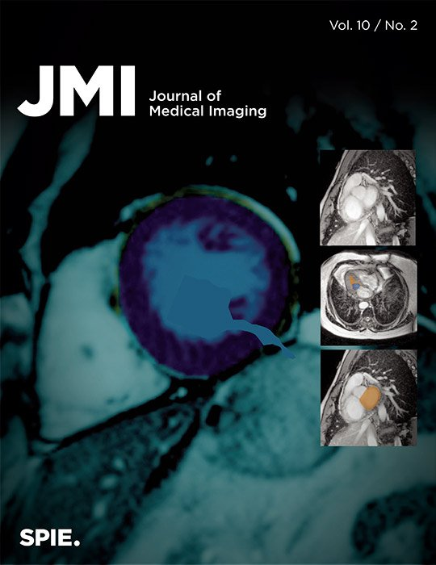
Journal of Medical Imaging
02. Journals
JMI
Scope :
Fundamental and translational research, applications, focused on medical imaging
Imaging physics, Tomographic reconstruction algorithms, Image processing and deep learning, Computer-aided diagnosis and quantitative image analysis, Visualization and modeling, Picture archiving and communications systems, Image perception and observer performance, Technology assessment, Ultrasonic imaging, Image-guided procedures, Digital pathology, Biomedical applications of biomedical imaging, …
Peer review
Single blind
FAPS – INF6900 (Medical Image Computing)

Slide 42
Journal of Medical Imaging – top cited papers (Publish or Perish, Google Scholar search)
02. Journals
JMI
Recurrent residual U-Net for medical image segmentation
662 citations on Google Scholar in July 2024
Published in 2019
Digital mammographic tumor classification using transfer learning from deep convolutional neural networks
622 citations on Google Scholar in July 2024
Published in 2016
Virtual clinical trials in medical imaging: a review
161 citations on Google Scholar in July 2024
Published in 2020
Computed tomography recent history and future perspectives
82 citations on Google Scholar in July 2024
Published in 2021
FAPS – INF6900 (Medical Image Computing)

Slide 43
IEEE Transactions on Medical Imaging
02. Journals
IEEE TMI
Subject areas
Imaging of body structure, Morphology and function, Original contributions on medical imaging achieved by different imaging modalities (ultrasound, x-rays, MRI, radionuclides, microwaves, optical methods). Contributions describing novel acquisition techniques, medical image processing and analysis, visualization and performance, pattern recognition, machine learning are encouraged.
Peer review
Single blind
FAPS – INF6900 (Medical Image Computing)

Slide 44
IEEE Transactions on Medical Imaging – top cited papers (Publish or Perish, Google Scholar search)
02. Journals
IEEE TMI
Deep Convolutional Neural Networks for Computer-Aided Detection: CNN Architectures, Dataset Characteristics and Transfer Learning
6011 citations on Google Scholar in July 2024
Published in 2016
The Multimodal Brain Tumor Image Segmentation Benchmark (BRATS)
5804 citations on Google Scholar in July 2024
Published in 2014
Inf-Net: Automatic COVID-19 Lung Infection Segmentation From CT Images
1149 citations on Google Scholar in July 2024
Published in 2021
CA-Net: Comprehensive Attention Convolutional Neural Networks for Explainable Medical Image Segmentation
470 citations on Google Scholar in July 2024
Published in 2020
FAPS – INF6900 (Medical Image Computing)

Slide 45
Nature Biomedical Engineering
02. Journals
Nat. Bio. Eng.
Not specifically for Medical Imaging Computing, but :
Advances in applied biomedicine and health technology
Some topics of interest : Artificial Intelligence, Biomedical imaging, biomedical sensors, Computational medicine, Translational medicine, …
« Nature Biomedical Engineering covers experimental and computational systems, methods, devices, therapies, technology and processes that facilitate the understanding of human disease, or its prevention, diagnosis, treatment, alleviation or monitoring. »
Peer review
Single blind
FAPS – INF6900 (Medical Image Computing)

Slide 46
Nature Biomedical Engineering – top cited papers (Publish or Perish, Google Scholar search)
02. Journals
Nat. Bio. Eng.
Near-infrared fluorophores for biomedical imaging
2390 citations on Google Scholar in July 2024
Published in 2017
Prediction of cardiovascular risk factors from retinal fundus photographs via deep learning
1596 citations on Google Scholar in July 2024
Published in 2018
First-in-human liver-tumour surgery guided by multispectral fluorescence imaging in the visible and near-infrared-I/II windows
741 citations on Google Scholar in July 2024
Published in 2020
Development and validation of a deep-learning algorithm for the detection of polyps during colonoscopy
451 citations on Google Scholar in July 2024
Published in 2018
FAPS – INF6900 (Medical Image Computing)

Slide 47
Scientific Reports
02. Journals
Sci. Rep.
Scope
Very broad : original research from across all areas of the natural sciences, psychology, medicine and engineering
Easier journal to publish in than others, has a large reach and articles with high citations counts
Peer review
Single blind
FAPS – INF6900 (Medical Image Computing)

Slide 48
Scientific Reports – top cited papers (Publish or Perish, Google Scholar search)
02. Journals
Sci. Rep.
COVID-Net: a tailored deep convolutional neural network design for detection of COVID-19 cases from chest X-ray images
3332 citations on Google Scholar in July 2024
Published in 2020
QuPath: Open source software for digital pathology image analysis
5167 citations on Google Scholar in July 2024
Published in 2017
SwissADME: a free web tool to evaluate pharmacokinetics, drug-likeness and medicinal chemistry friendliness of small molecules
10749 citations on Google Scholar in July 2024
Published in 2017
Reproducibility of radiomics for deciphering tumor phenotype with imaging
530 citations on Google Scholar in July 2024
Published in 2016
FAPS – INF6900 (Medical Image Computing)

Slide 49
Overview of all 5 journals
02. Journals
Journal | Editor family | Impact factor | Review blindness | Open Access | Link with a conference ? | Time for the review process
Medical Image Analysis (MEDIA) | Science Direct | 10.7 (2023) | Single blind | Yes | Yes, MICCAI | 264 days (average submission to acceptance)
IEEE Transactions on Medical Imaging (IEEE TMI) | IEEE | 8.9 (2023) | Single blind | Yes (it’s an option) | Yes, IEEE linked conferences | 7 weeks (submission to decision)
Scientific Reports | Nature | 3.8 (2023) | Single blind | Yes | No | 140 days (submission to acceptance)
Journal of Medical Imaging (JMI) | SPIE | 1.9 (2023) | Single blind | Yes | No | Information not found
Nature Biomedical Engineering | Nature | 26.8 (2023) | Single blind | Yes (it’s an option) | No | 316 days (submission to acceptance)
FAPS – INF6900 (Medical Image Computing)

Slide 50
More journals
02. Journals
It can be very relevant to look for journals specifically related to the pathology that we are studying, or the anatomy, especially if we have a focus on clinical findings, and methods that could be applied to the clinic
For example
JACC : Cardiovascular Imaging (Impact factor : 12.8 (2023))
Ophthalmology (Impact factor : 13.7 (2023))
Journal of Clinical Oncology (Impact factor : 42.1 (2023))
FAPS – INF6900 (Medical Image Computing)

