Slide 1
DATE: Detecting Anomalies in Text via Self-Supervision of Transformers Andrei Manolache, Florin Brad, Elena Burceanu

Slide 2
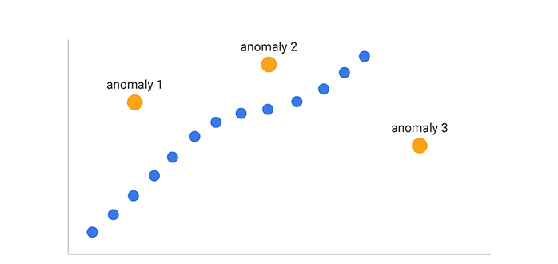
Anomaly Detection
Deviation from expected behaviour
Neural network
→ High performance

Slide 3
Self-Supervision via Transformer
Je veux une bonne note à ma présentation
I want a good grade for my presentation
Input sequence
Output sequence
Supervision x Unsupervision
Self-supervision

Slide 4
Objective ?
Anomaly Detection
Self-supervised learning
Transformer
→ Detecting Anomalies in Text via Self-Supervision of Transformers
Credit card fraud
Malware / Spam detection
Intrusion Detection System
Use ?

Slide 5
Training
mask 1
…
mask K
…
replaced
original
Discriminator
x = They were prepared to depart
Generator
[0, 0, 1, 0, 1]
[0, 0, 1, 1, 1]
[1, 0, 1, 0, 1]
…
[0, 0, 0, 0, 1]
x = They were [MASK] to [MASK]
K mask patterns
Input masking
x = They were ready to go

Slide 6
Testing
PL low → anomaly
PL = Pseudo Label Score
PL = mean( , … , )
Discriminator
x = indie movies grow in popularity

Slide 7
Result
PL
Play
Practise
Scheduled
Judge
Bankuptcy
Arguments
DATE
Performance = 95%
Outperforms state-of-the-art results
Databases
Engine
Versions
Complete
Leaders
Hall
Invade
Performance = 84%
DATE

Slide 8
Conclusion
Self-supervision
Specific database
A former Conservative strategist was Chief of Staff to former Minister. He then played tennis with his friend.
Outperform state-of-the-art
Transformer
Test
! Anomaly
Mask pattern

