Slide 1
Constraint Programming
for
ATHN
Understanding our
PLANET
Tectonic Plates Theory

Slide 2
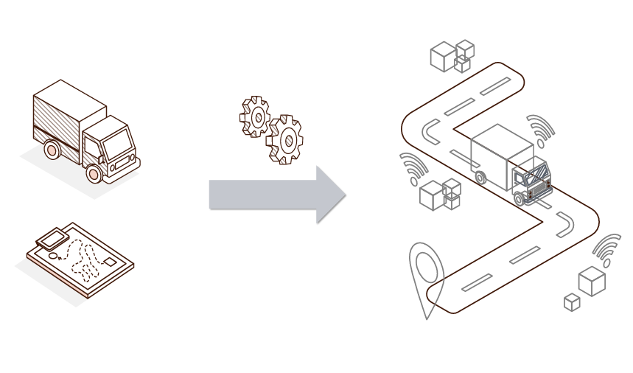
Table of contents
1. Introduction
2. Methodology
MIP
CP
3. Results
4. Conclusion

Slide 3
Authors
The paper
The problem
A
Methodology :
In 2 parts : MIP and CP.
MIP :
Scheduling problem with hubs and use of a clever formulation
Contribution :
Capacity minimization at the hubs
Base of research :
«Optimizing Autonomous Transfer Hub Networks : Quantifying the Potential Impact of Self-Driving Trucks.»
Motivation :
Industrial impact is strong, easy big scale testing, new approach
Contribution :
Utilization of MIP and CP for automation and scheduling of freight problems

Slide 4
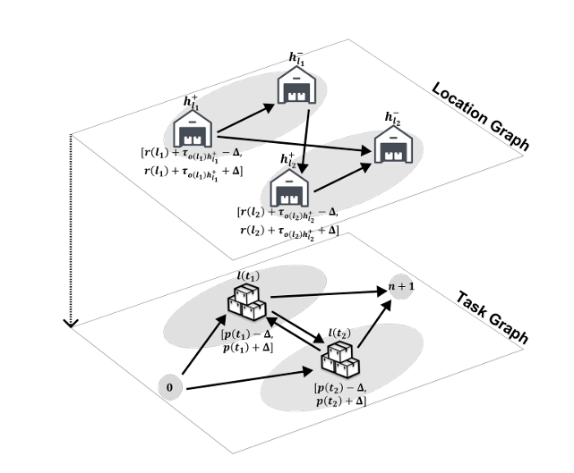
MIP - Example
- Simplistic example:
4 hubs and 2 tasks
- MIP :
Task Graph G = (V,A)
Min-cost flow problem
- 3 possibilities for a truck:
No automation
Only one automated task
Several consecutive tasks

Slide 5
CP
Variables and parameters
Modeling
The 4 properties of jobs :
Type(j) 𝜖 {l,d,u,r,p}
Duration(j) : job duration
Task(j) (only for l,u,d): associated task
Hub(j) (only for l,u,p) : associated hub
$S_{j}^{k}$ = start time of job j on route k
$C_{h}$ = unloading/unloading capacity required by hub h ∈ H
Jobs are used instead of tasks
Numbering in order of performance

Slide 6
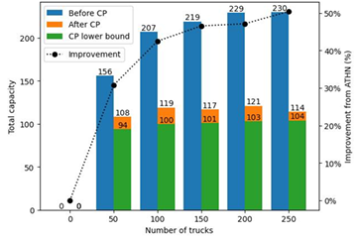
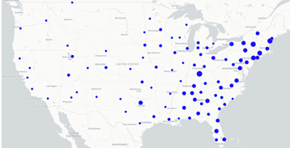
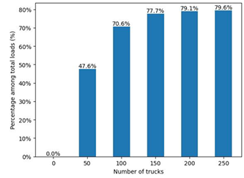
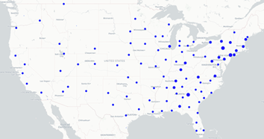
Case study - Results
Hub capacities
Comparison
MIP
Automation
CP

Slide 7
Conclusion – Questions ?
Initial work
CP Modeling
Results
Future work
Autonomous transfer hub networks – Théau Lepouttre
Your Name Here :)

Slide 8
THANK YOU FOR LISTENING!

Slide 9
Credits
Font
Josefin Sans: https://fonts.google.com/specimen/Josefin+Sans
Illustration + animation
Slidenest : https://slidenest.com/
Images :
https://unblast.com/problem-solving-illustration-ai/
https://www.vecteezy.com/vector-art/2766892-mosaic-linear-icon-search-for-missing-piece-challenge-for-logic-solving-maze-jigsaw-thin-line-customizable-illustration-contour-symbol-vector-isolated-outline-drawing-editable-stroke
Scientific article
Constraint Programming to Improve Hub Utilization in Autonomous Transfer Hub Networks
Optimizing Autonomous Transfer Hub Networks : Quantifying the Potential Impact of Self-Driving Trucks

